Slide 1
EVENT AS A PARTICLE CLOUD
Dynamic Graph Convolutional Neural Networks
Supervisor:
Dr Sudarshan Paramesvar
Russell Zhang

Slide 2
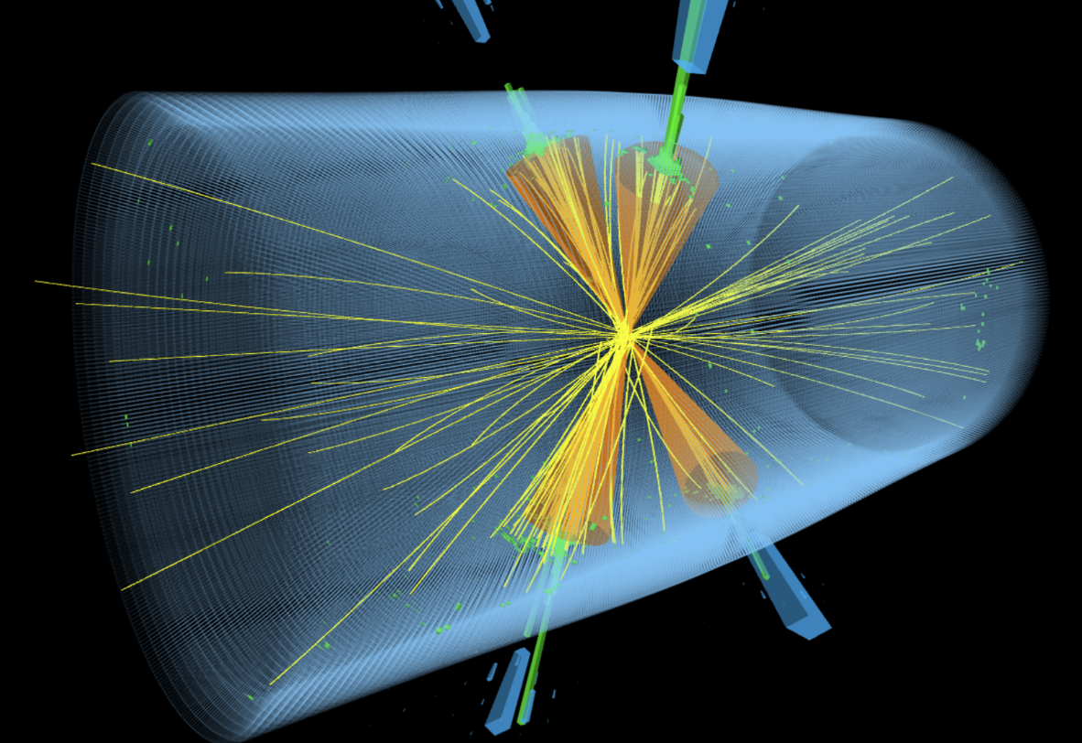
Introduction

Slide 3
Introduction
Background and Motivation
Zillions of data generated in LHC in microseconds.
Physicists are only interested in some of them (signals)
Develop an algorithm which can help us select signals efficiently. (goal)
Compare between different neural networks and find the optimal. (goal)
CMS detector
signal
bkg
L1 trigger system
Machine Learning Algorithm
signal

Slide 4
Introduction
How can we measure the collision events as data?
CMS detector
signal
bkg
L1 trigger system
Machine Learning Algorithm
signal

Slide 5
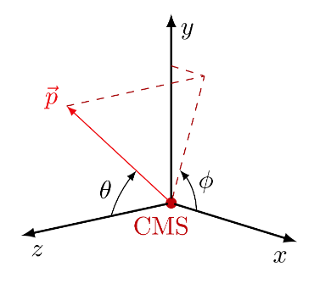

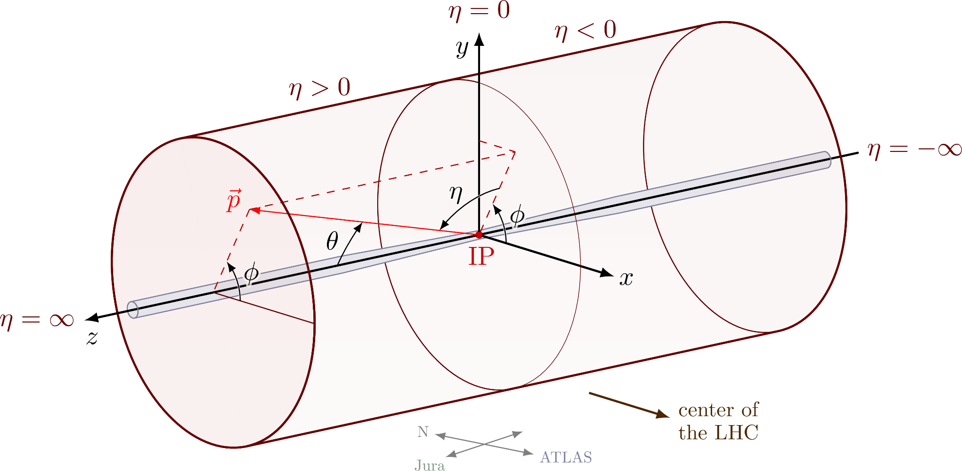
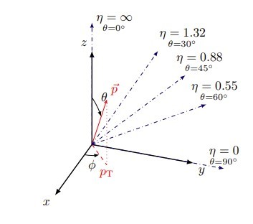
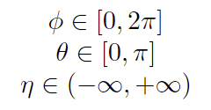
Introduction
pseudorapidity-azimuth space
pT: momentum (energy)

Slide 6
Introduction
pseudorapidity-azimuth space
pT: momentum (energy)

Slide 7
Introduction
pseudorapidity-azimuth space
pT: momentum (energy)
offer sufficient background to represent event as a graph

Slide 8
Invariance in events

Slide 9
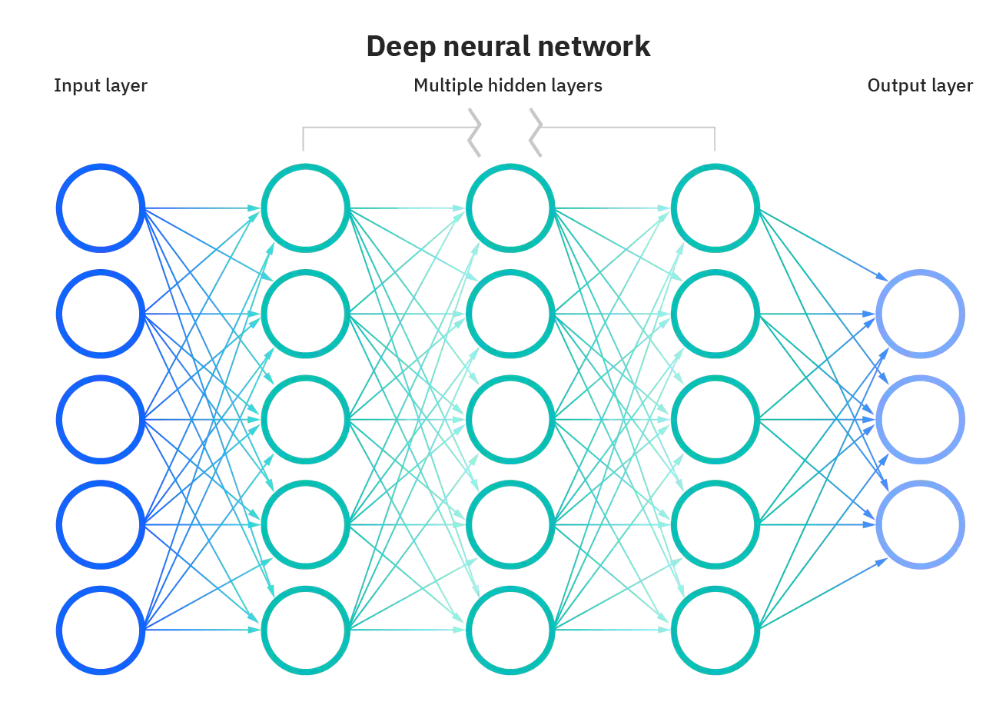
Deep Learning

Slide 10
Related works
How to represent a collision event is one of the key aspects of machine learning algorithms for fast selection.
Lots of the approaches and techniques has been proposed in the past few years…

Slide 11
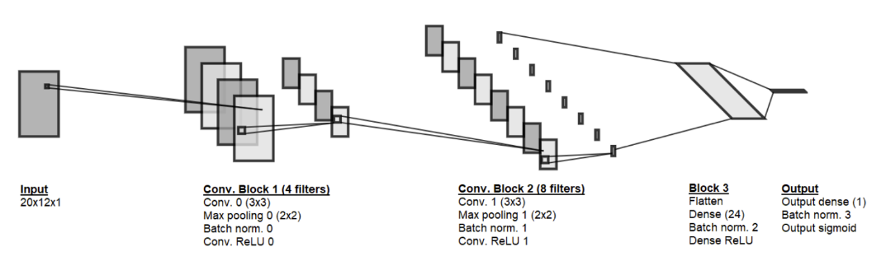
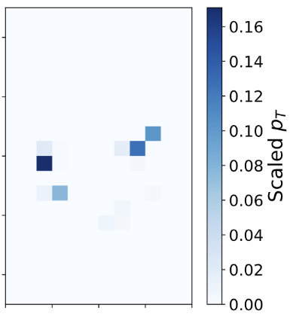
Related works
How to represent a collision event is one of the key aspects of machine learning algorithms for fast selection.
Lots of the approaches and techniques has been proposed in the past few years…
As images
computer vision
CNN

Slide 12
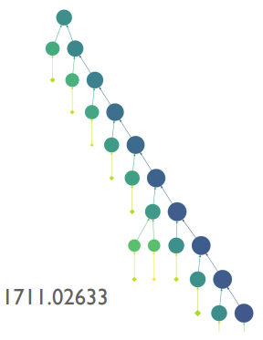
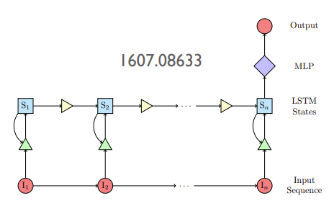
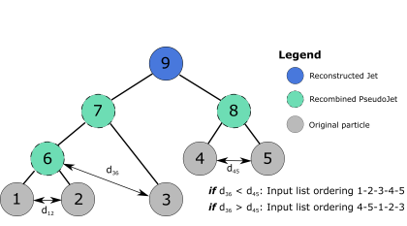
Related works
How to represent a collision event is one of the key aspects of machine learning algorithms for fast selection.
Lots of the approaches and techniques has been proposed in the past few years…
As images
computer vision
As sequences
CNN
speech recognition
RNN / LTSM

Slide 13
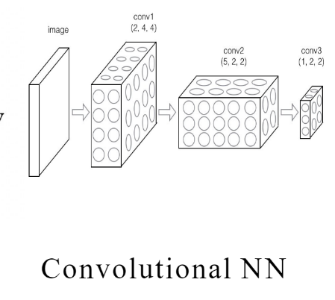
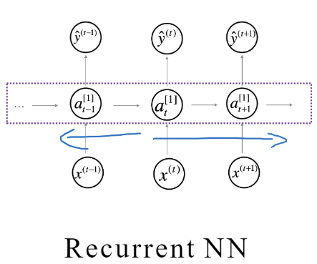
Are they really good enough?

Slide 14
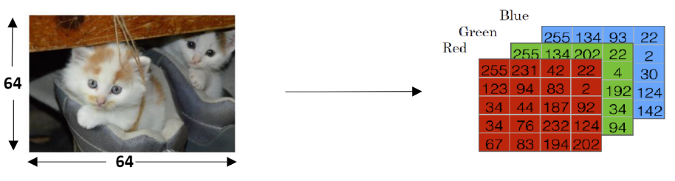
Image
Advantages
can benefit directly from powerful and complex algorithms (CNNs) from the computer vision community
Disadvantages
images are uniform grids of pixels:
1. projecting particles into pixels leads to high sparsity and loss of granularity
2. also nontrivial to include features other than particle energy/momenta (e.g., track impact parameters)
RGB data:（ N, M, 3 ）matrix

Slide 15
Sequence
Advantages:
1. preserves full granularity, no loss of information from pixelation straightforward
2. to include any features for each particle
Disadvantages:
all sequence-based algorithm (RNN/RecNN/1D CNN) assumes an explicit ordering but particles in an event are unordered

Slide 16
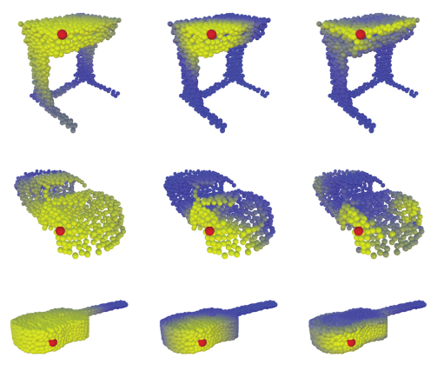
How about a point cloud ?

Slide 17
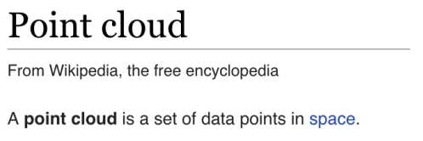
Point Cloud
shares all the benefits of sequence and points are unordered

Slide 18
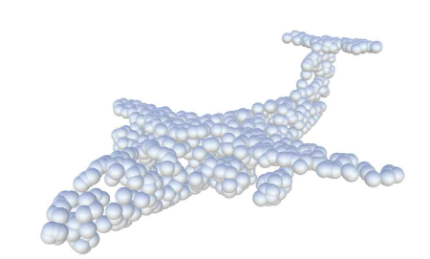
point
Why not regard point as a particle?

Slide 19
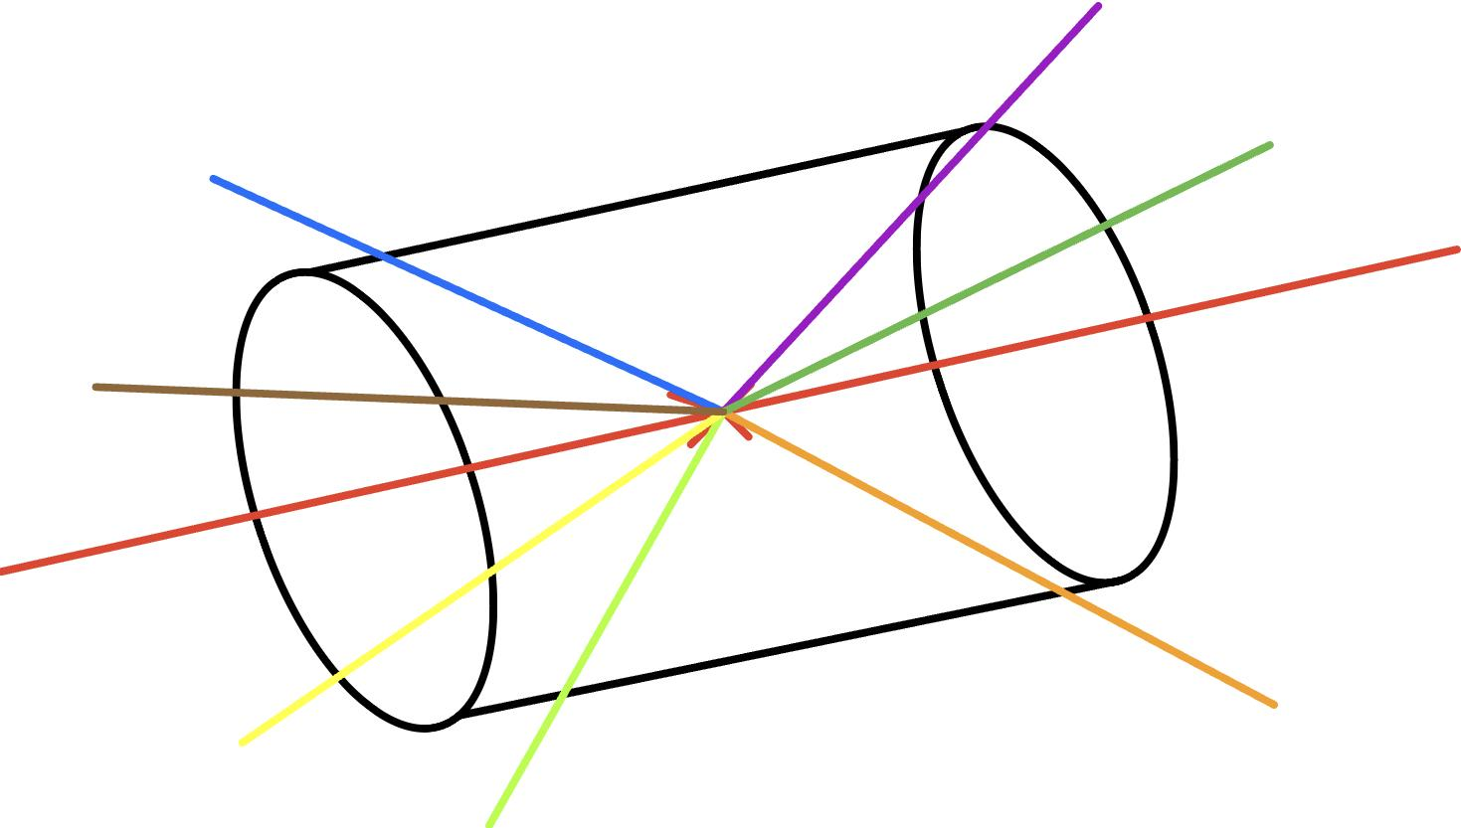
Event as a particle cloud
An event is a set of particles in the space.
Particle clouds are generally created by clustering a large number of particles measured by the particle detectors.

Slide 20
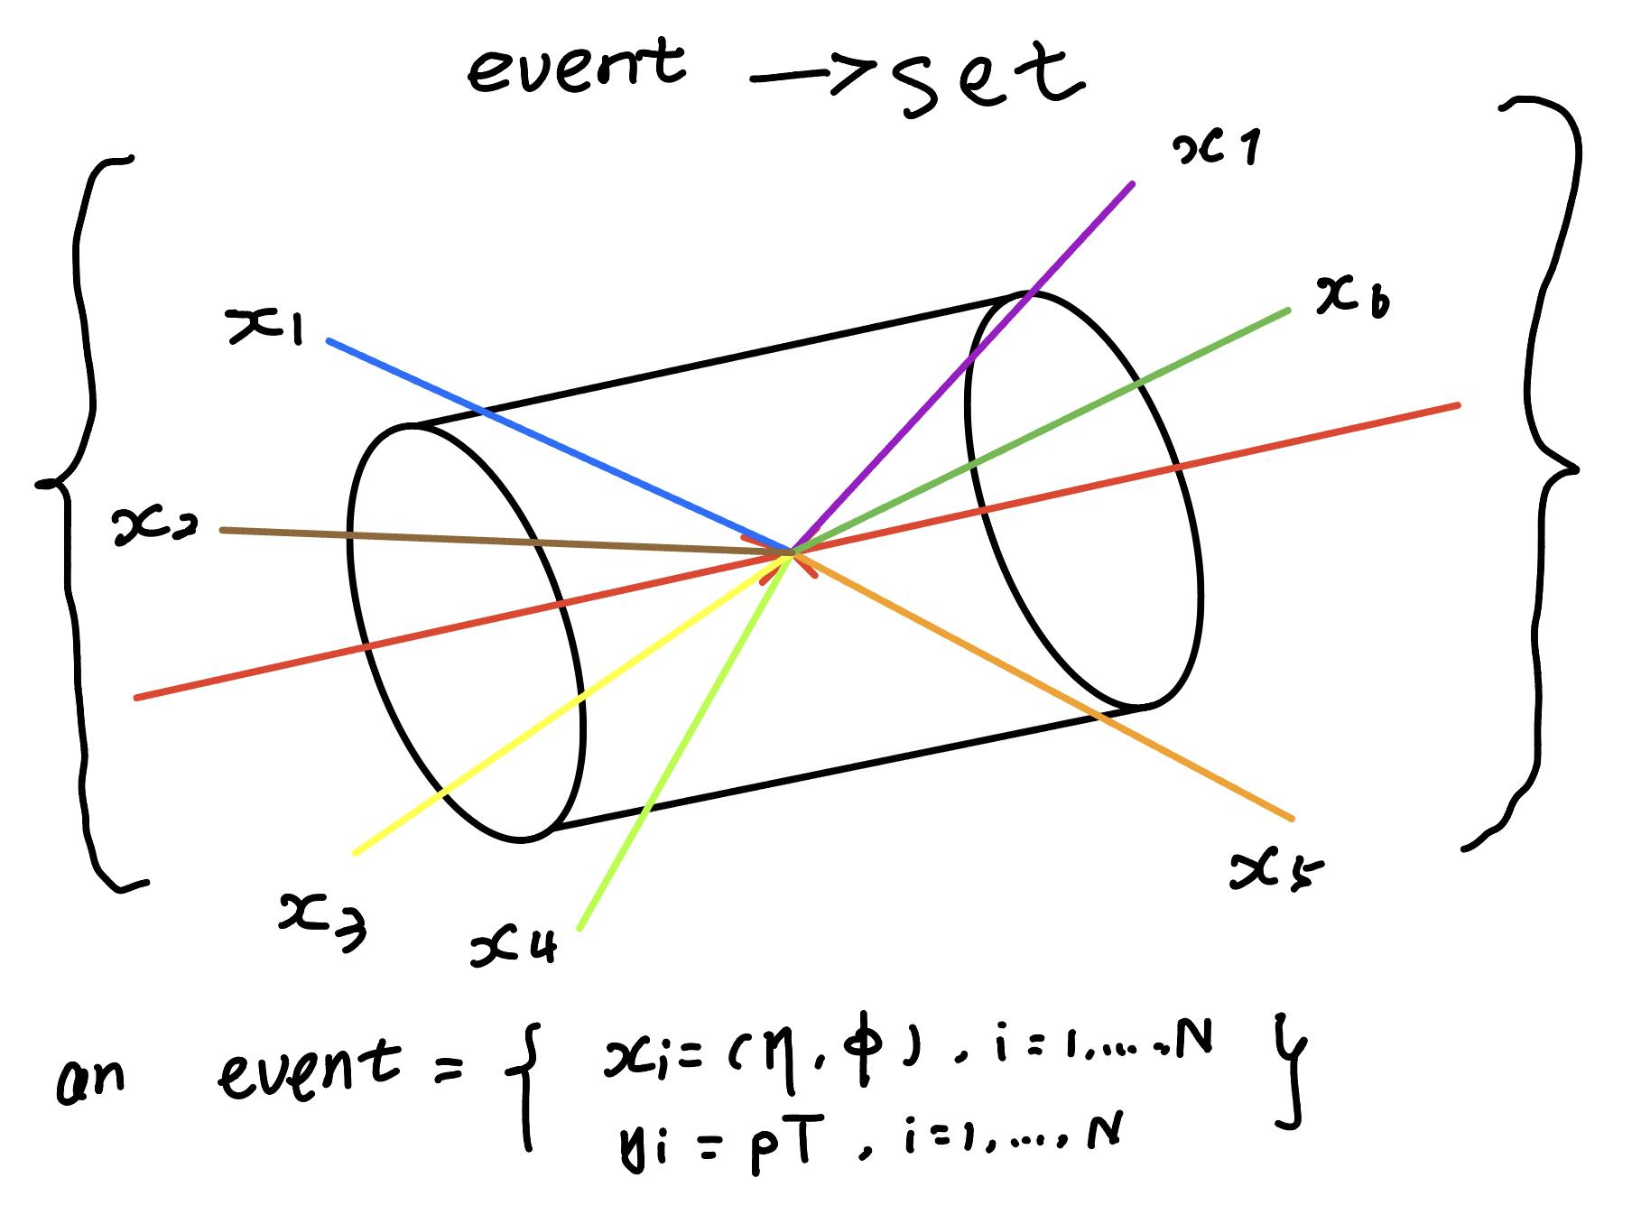
Event as a particle cloud
An event is a set of particles in the space.
Particle clouds are generally created by clustering a large number of particles measured by the particle detectors.

Slide 21
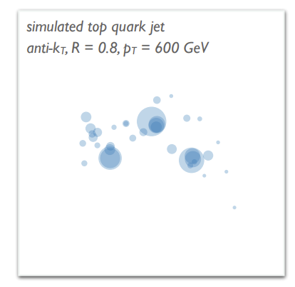

Event as a particle cloud
An event is a set of particles in the space.
Particle clouds are generally created by clustering a large number of particles measured by the particle detectors.

Slide 22
Event as a particle cloud
An event is a set of particles in the space.
Particle clouds are generally created by clustering a large number of particles measured by the particle detectors.
(We also stored corresponding features)

Slide 23
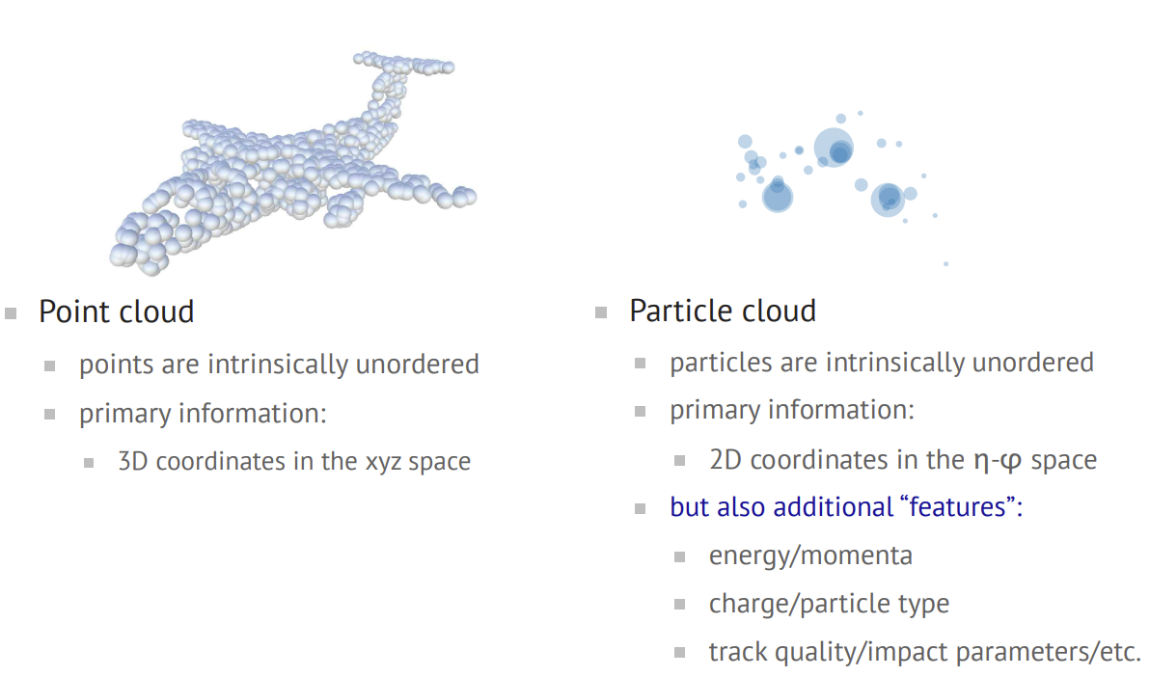

Slide 24
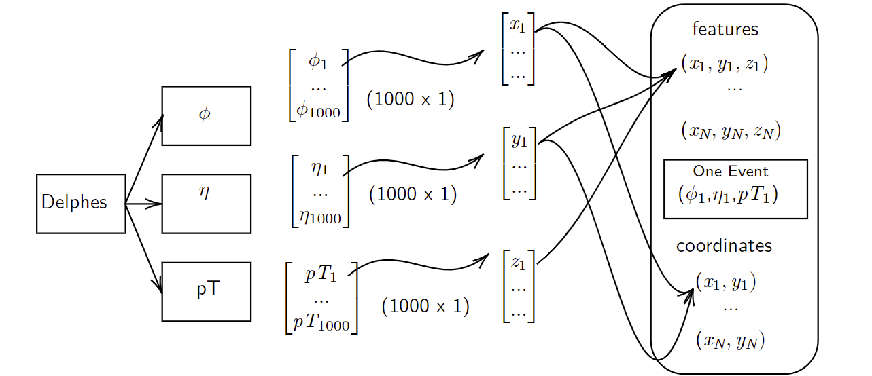
Make our dataset readable for Deep Learning (arrays)
(Take 1000 samples as example)

Slide 25


Neural Networks from scratch
x₁
w1
a₁
h
z₁
w2
x₂
a₂
h
z₂
w3
x₃
…
…
w_{D}
…
a_{M}
h
z_{M}
x_{D}
weights
activation

Slide 26
Neural Networks from scratch
x₁
w1
a₁
h
z₁
w2
x₂
a₂
h
z₂
w3
x₃
…
…
w_{D}
…
a_{M}
h
z_{M}
x_{D}
weights
activation

Slide 27
Neural Networks from scratch
x₁
z₁
x₂
z₂
x₃
…
…
z_{M}
x_{D}

Slide 28



Neural Networks from scratch
x₁
z₁
y₁
x₂
z₂
…
x₃
…
y_{K}
…
z_{M}
x_{D}

Slide 29
Full-connected Feed-forward Neural Networks
x₁
z₁
y₁
x₂
z₂
…
x₃
…
y_{K}
…
z_{M}
x_{D}

Slide 30
Full-connected Feed-forward Neural Networks
multilayer perceptron (MLP)
x₁
z₁
y₁
x₂
z₂
…
x₃
…
y_{K}
…
z_{M}
x_{D}

Slide 31
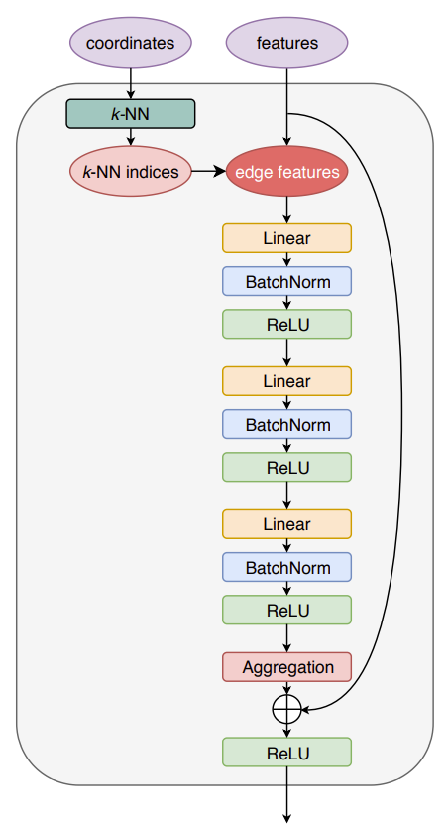
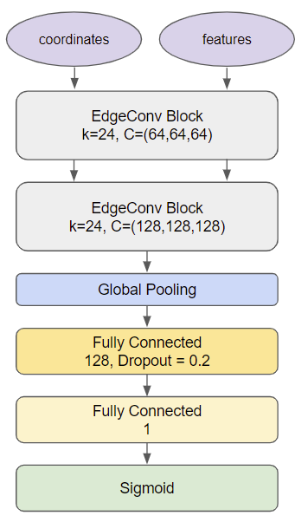
ParticleNetLite++
Dynamic Graph Convolutional Neural Networks
Dataset
Encoder
Decoder

Slide 32
ParticleNetLite++
Dynamic Graph Convolutional Neural Networks
Dataset
Encoder
Decoder

Slide 33
ParticleNetLite++
Dynamic Graph Convolutional Neural Networks
Dataset
Encoder
?
Decoder

Slide 34
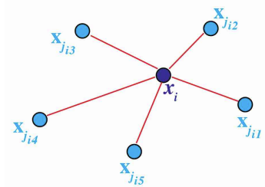
EdgeConv
K-Nearest-Neighbors
Goal: To make every particle and his k neighbors as a graph.

Slide 35
EdgeConv
K-Nearest-Neighbors
Goal: To make every particle and his k neighbors as a graph.
k=5

Slide 36
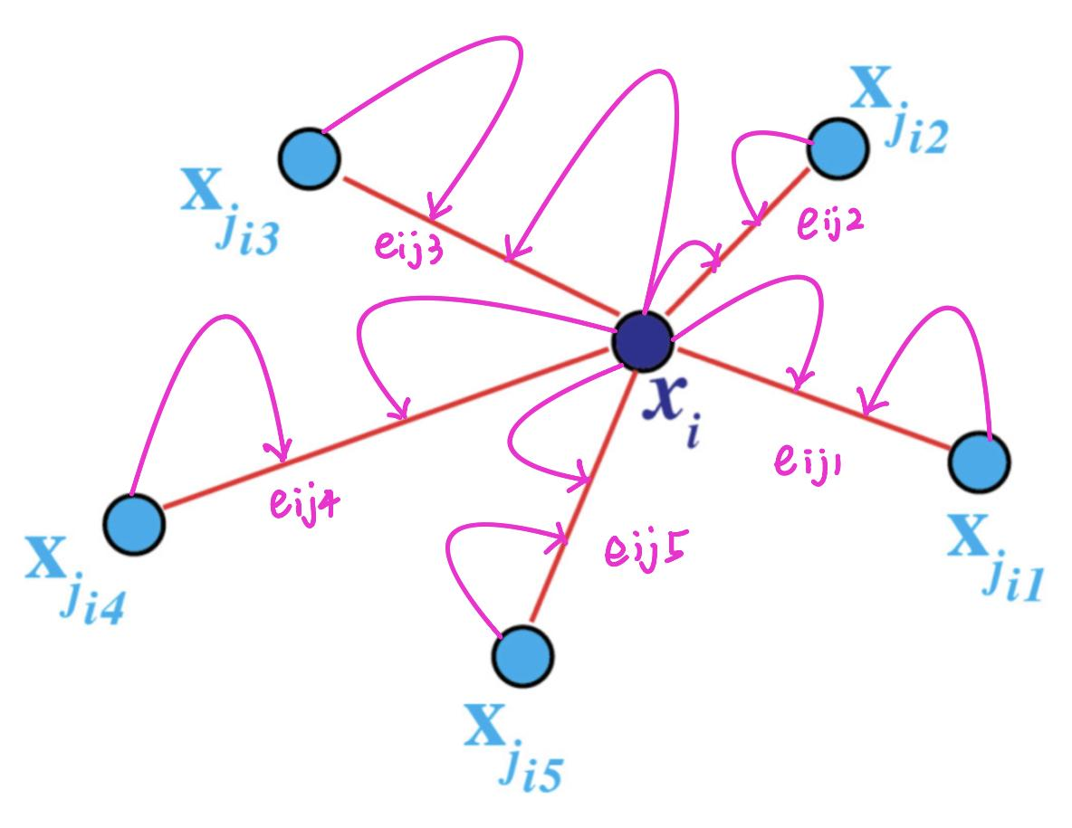
EdgeConv
Use particle features to update the edge features

Slide 37
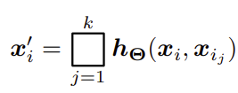
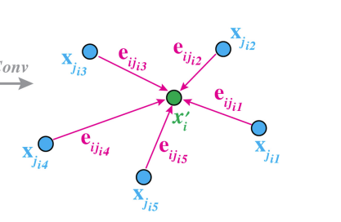
EdgeConv
Use edge features to update particle features

Slide 38
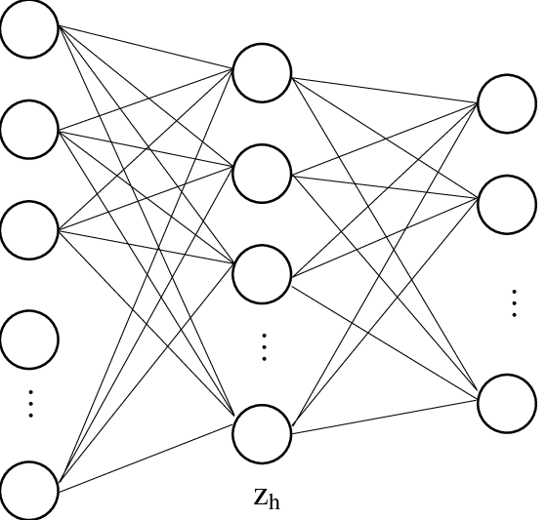
EdgeConv
Updated Dataset
x₁
x₂
x₃
x₄
x₅
x₆
x₇
.
.
.
.
x_{N}

Slide 39
EdgeConv
Skip Connect
With the deepening of the number of deep network layers：
gradient disappearance,
gradient explosion,
overfitting
consumption of computing resources.

Slide 40
Why Dynamic?
pseudorapidity-azimuth space

Slide 41
Why Dynamic?
Euclidean space

Slide 42
Global Pooling
With Global pooling reduces the dimensionality from 3D to 1D.
(phi, eta, pT)
Therefore Global pooling outputs 1 response for every feature map. This can be the maximum or the average or whatever other pooling operation you use.
(sum, median, mean, average. maximum, operation)

Slide 43
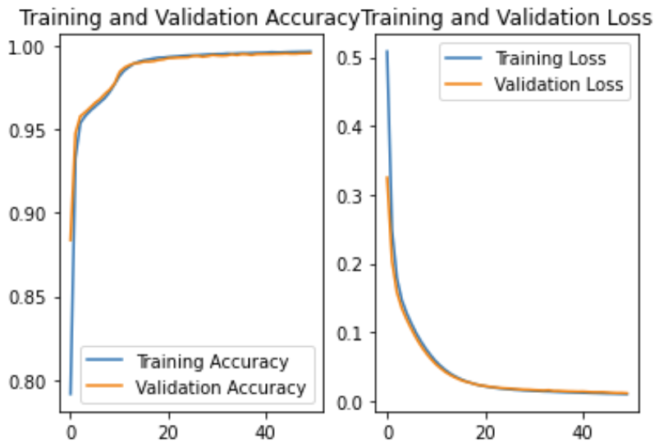
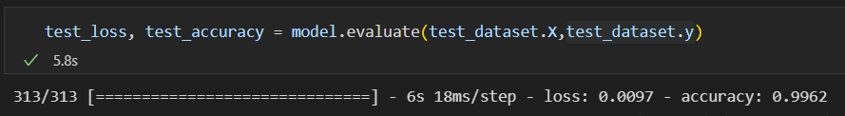
Experiments Results

Slide 44
Next Stage
Use more methods to verify the model accuracy (Cross-validation KFold)
Reduce the size of events to reduce the computational cost.
Find the optimal parameters combination both for computational cost and accuracy.
Finish the final report (plan to make the complete mathematical inference and operation, also offer different learning strategies for data.)
Organize the implementation code and add detailed comments.

Slide 45
Reference
[1] Qu, Huilin, and Loukas Gouskos. "Jet tagging via particle clouds." Physical Review D 101.5 (2020): 056019.
[2] I. Henrion, J. Brehmer, J. Bruna, K. Cho, K. Cranmer, G. Louppe, and G. Rochette, “Neural Message Passing for Jet Physics,” in Deep Learning for Physical Sciences Workshop at the 31st Conference on Neural Information Processing Systems (NIPS) (2017).
[3] P. T. Komiske, E. M. Metodiev, and J. Thaler, “Energy Flow Networks: Deep Sets for Particle Jets,” JHEP 01, 121 (2019), arXiv:1810.05165 [hep-ph].
[4] Y. Wang, Y. Sun, Z. Liu, S. E. Sarma, M. M. Bronstein, and J. M. Solomon, “Dynamic graph cnn for learning on point clouds,” ACM Trans. Graph. 38, 146 (2019).

Slide 46
Thanks

